Slide 1
Making decision using if and if else statement
By: M Usama
Code with MU

Slide 2
Types of statements
If statements
If/else statements
If/else if statements
Code with MU

Slide 3
If statements
The if statement can cause other statements to execute only under certain conditions.
Syntax:
if ( expression)
statement;
// write what you want to perform
No semicolon goes here.
semicolon goes here.
Code with MU

Slide 4
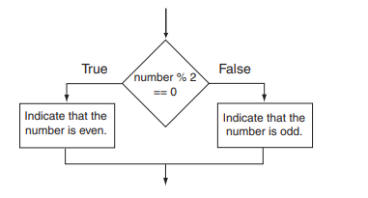
If else statements
The if/else statement will execute one group of statements if the expression is true, or another group of statements if the expression is false.
if ( expression)
statement or block
Else
statement or block
Code with MU

Slide 5
If/else if statements
if ( expression)
statement or block
Else if (expression)
statement or block
Else
statement or block
Code with MU

